Slide 1
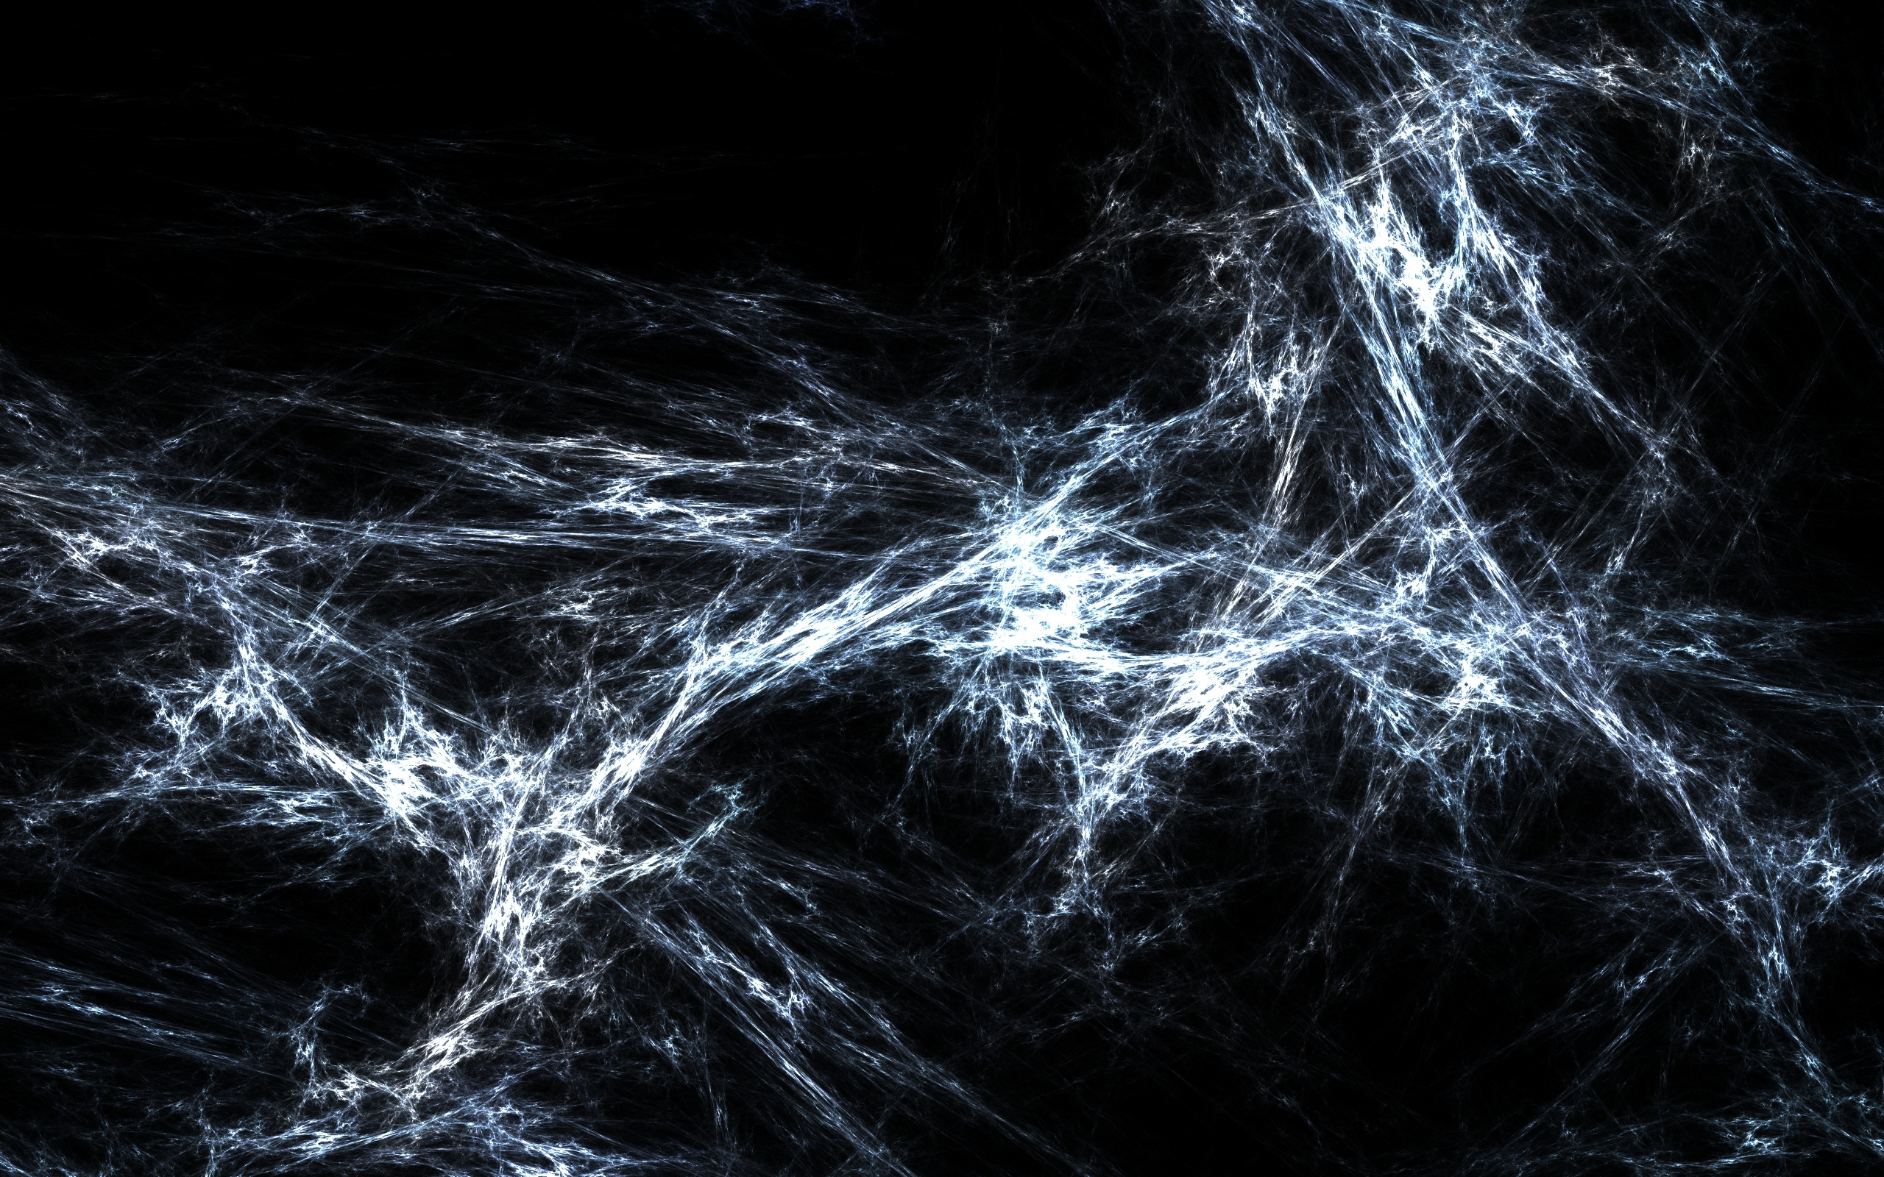
Atherosclerosis Detection in CT scan Images Using Deep Learning and AI Neural Networks
Abhinav Tyagi - 22202296
Yash Vats - 22204223
This Photo by Unknown author is licensed under CC BY-NC-ND.

Slide 2
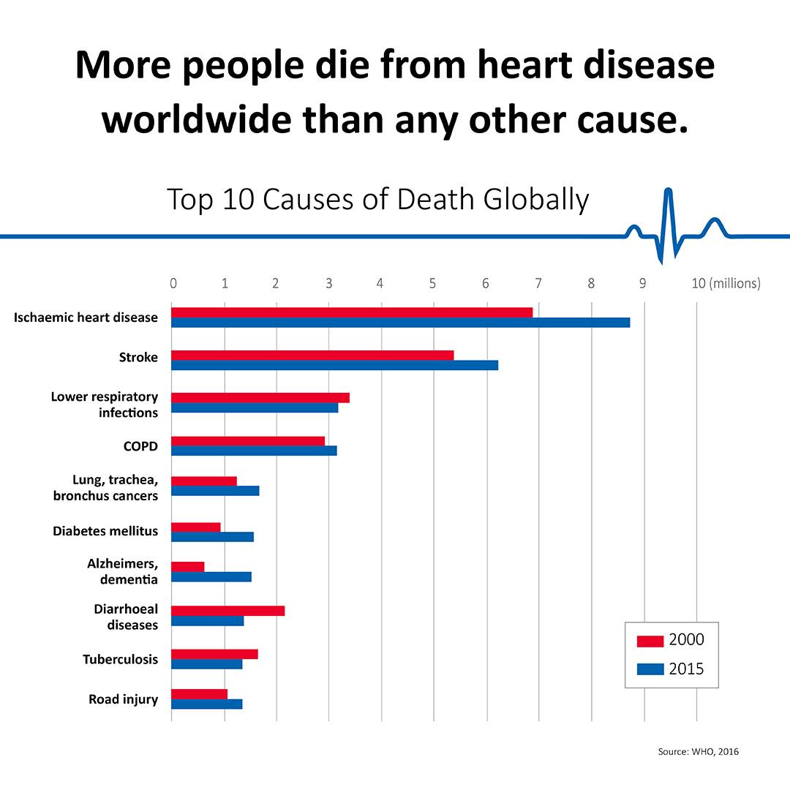

Slide 3
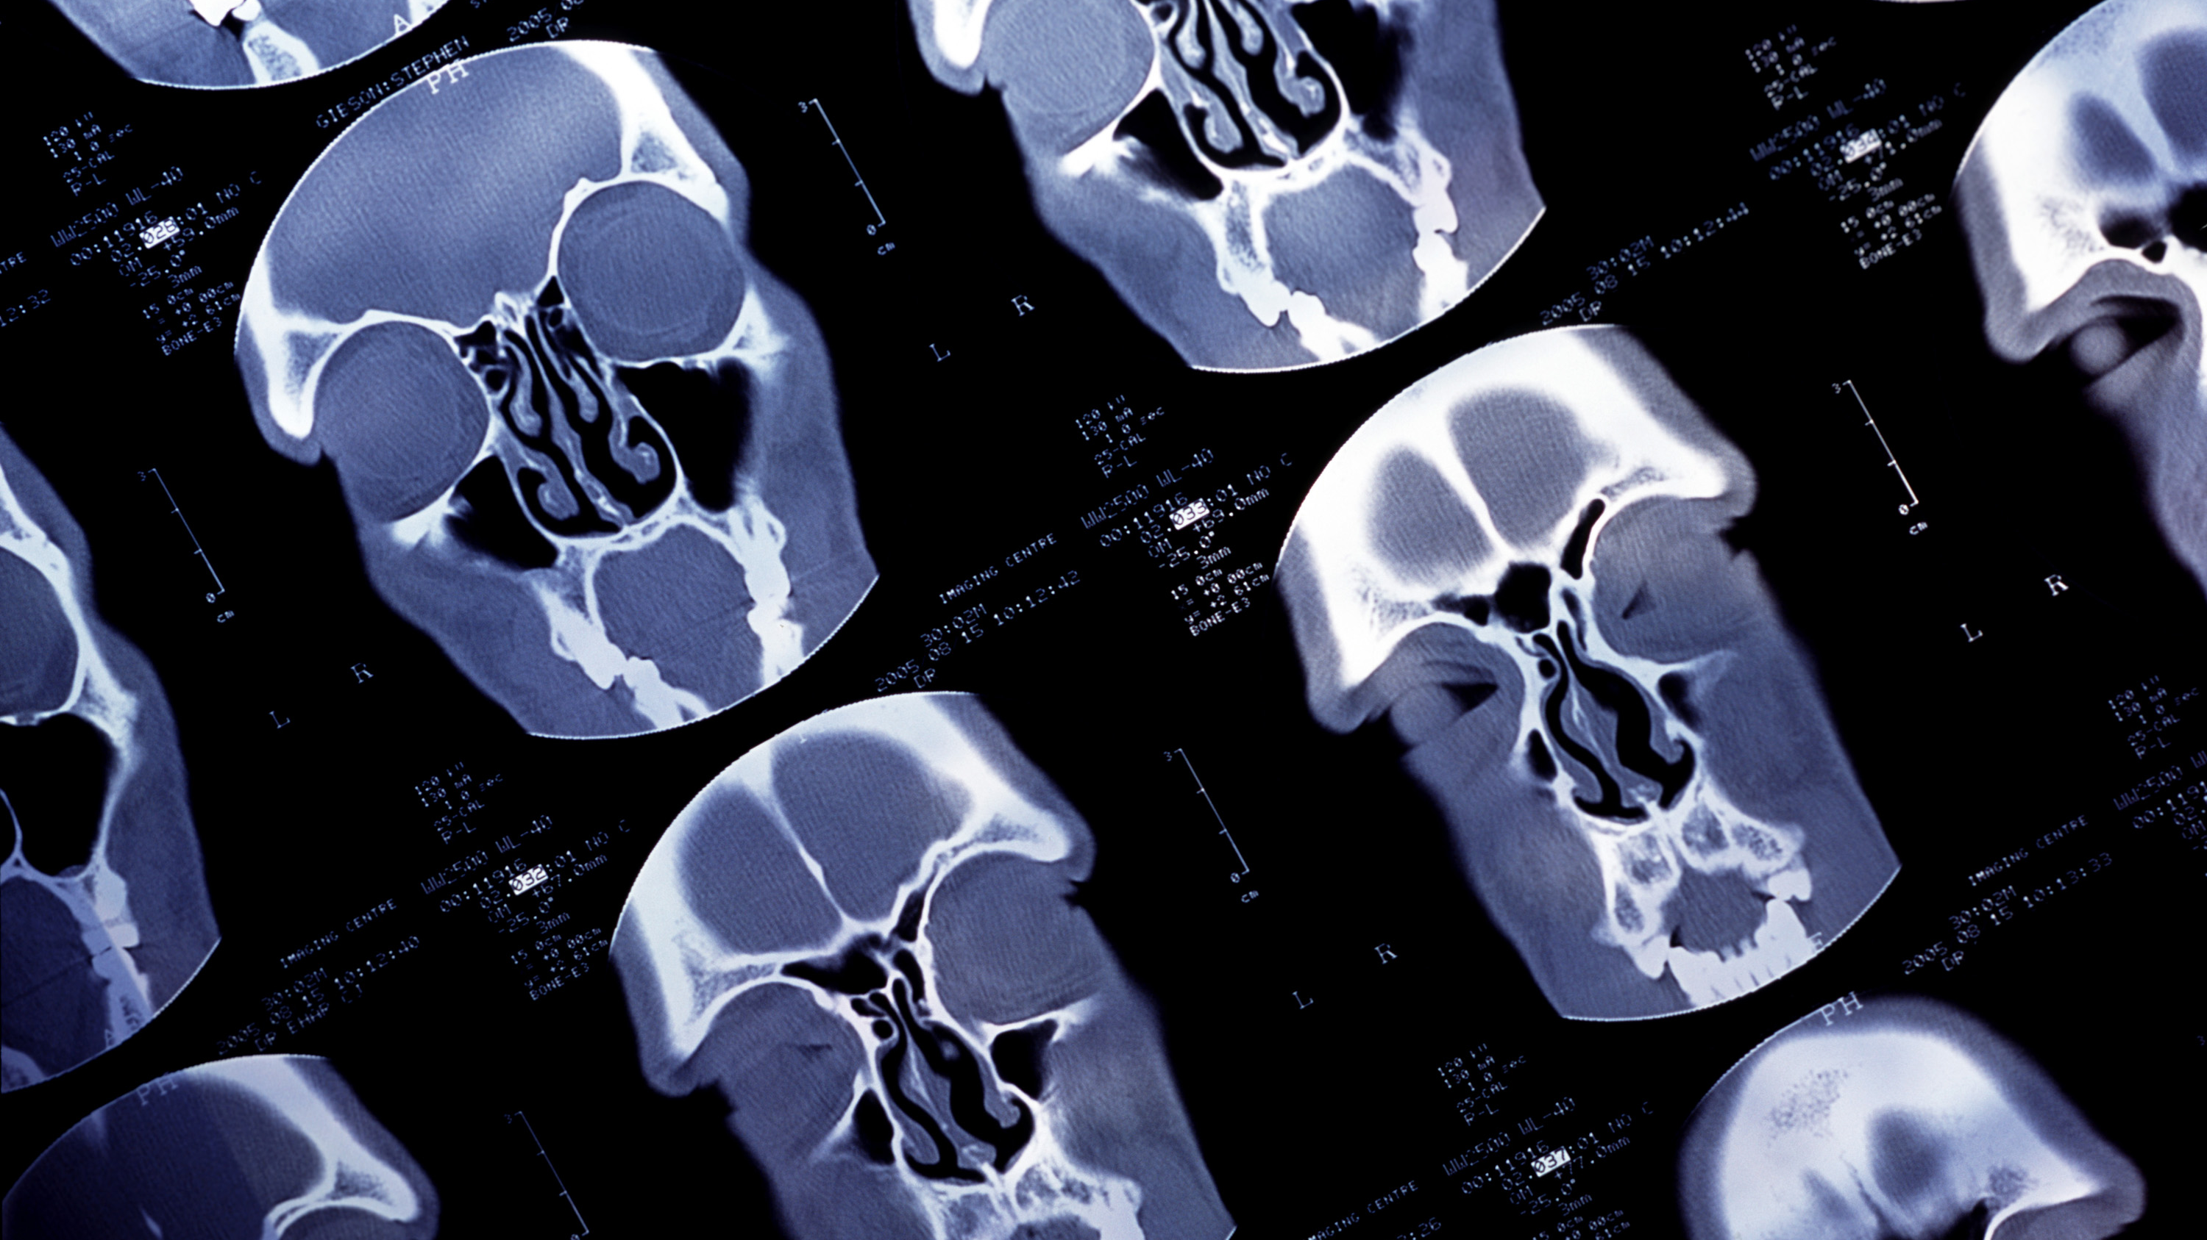
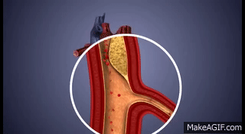
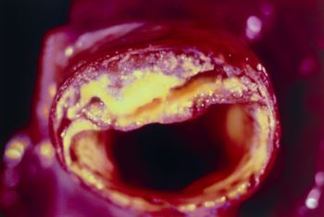
Introduction
What is Atherosclerosis ?
"Atherosclerosis is a chronic inflammatory disease characterized by the accumulation of fatty deposits, cholesterol, and other substances in the arterial walls."
"It is a leading cause of cardiovascular diseases such as heart attacks, strokes, and peripheral artery disease."
"Early detection and treatment of atherosclerosis are crucial for preventing severe complications and improving patient outcomes."
Motivation
"Ultrasound imaging is a non-invasive, cost-effective, and widely accessible technique for visualizing the internal structures of the body."
"Automated detection of atherosclerosis in ultrasound images can aid in early diagnosis, risk assessment, and treatment planning."
This Photo by Unknown author is licensed under CC BY.

Slide 4
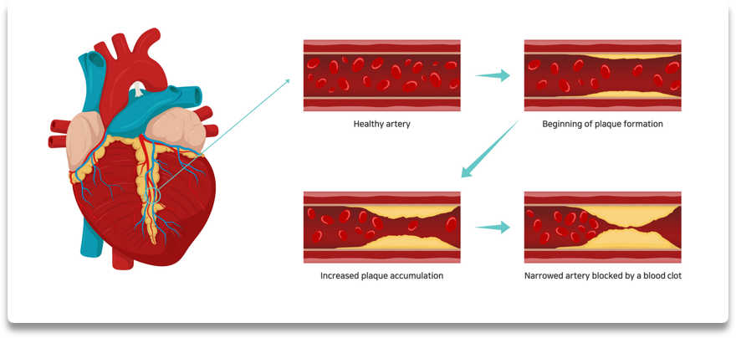
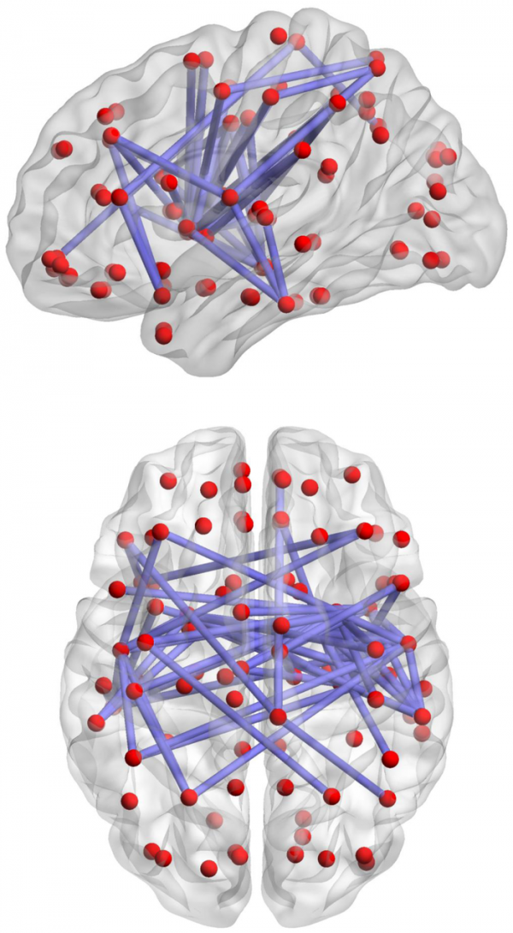
Objective
"The primary objective of this project is to develop a machine learning model for the automated detection of atherosclerosis in ultrasound images of the carotid artery."
"Specifically, we aim to train a deep learning model based on the U-Net architecture to segment and identify atherosclerotic plaques in the images."
"We also aim to evaluate the model's performance using metrics such as the Intersection over Union (IoU) score, precision, recall, and F1-score."
This Photo by Unknown author is licensed under CC BY-SA.

Slide 5
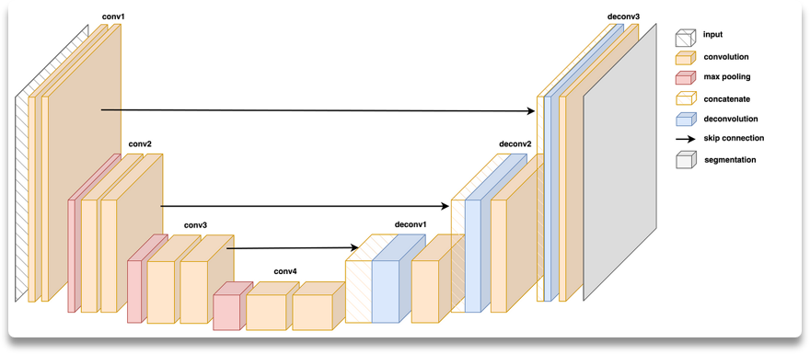
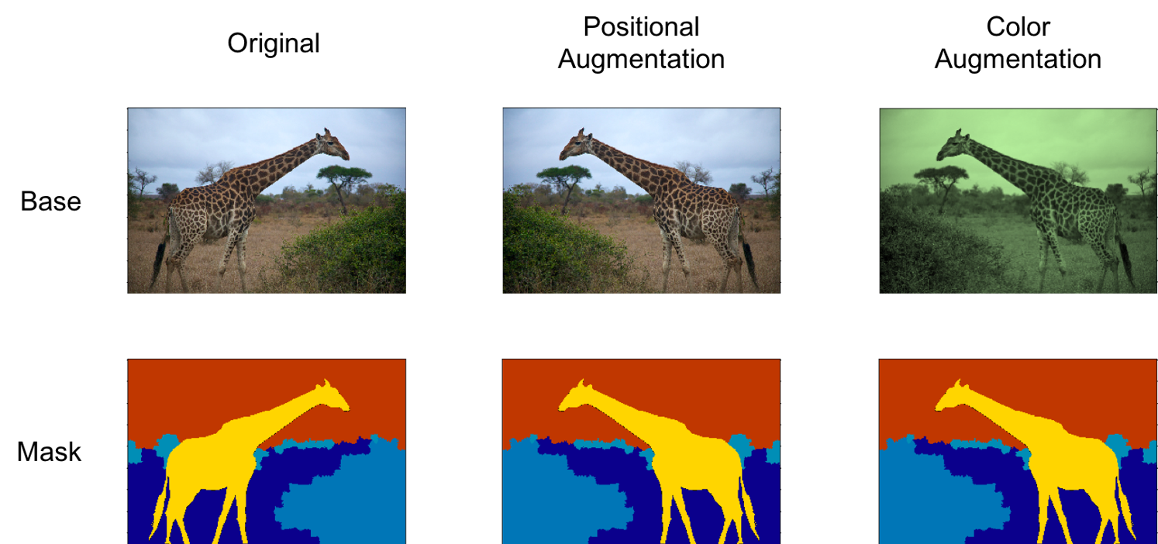
Methodology
The methodology for this project consists of several stages, including preprocessing, model development, training, evaluation, and interpretation."
"Preprocessing: The images were resized, normalized, and the labels were one-hot encoded. The dataset was split into training, validation, and test sets."
"Model Development: We used the U-Net architecture, a convolutional neural network (CNN) commonly used for image segmentation tasks."
"Training: The model was trained on the training set using the categorical cross entropy loss function and the Adam optimizer."
"Evaluation: The model's performance was evaluated on the test set using metrics such as IoU, precision, recall, and F1-score."
"Interpretation: We analyzed the results to understand the model's strengths and weaknesses and draw conclusions."

Slide 6
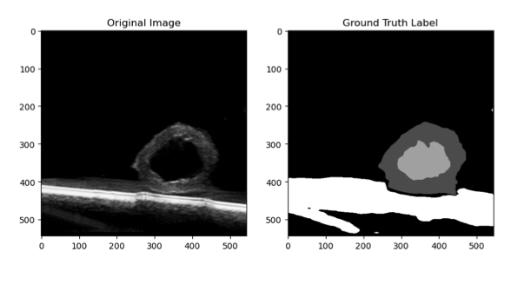
Dataset Analysis
"The dataset for this project consists of ultrasound images of the carotid artery, along with corresponding labels indicating the presence or absence of atherosclerotic plaques."
"The images were preprocessed to ensure consistency and suitability for the model."
"The labels were one-hot encoded to represent the presence or absence of plaques in a binary format."
"The dataset was split into training, validation, and test sets to ensure proper model training and evaluation."
As shown in Ground Truth Label
1. Background - Black
2. Plaque - Dark Gray
3. Lumen - Light Gray
4. Artifacts - White

Slide 7
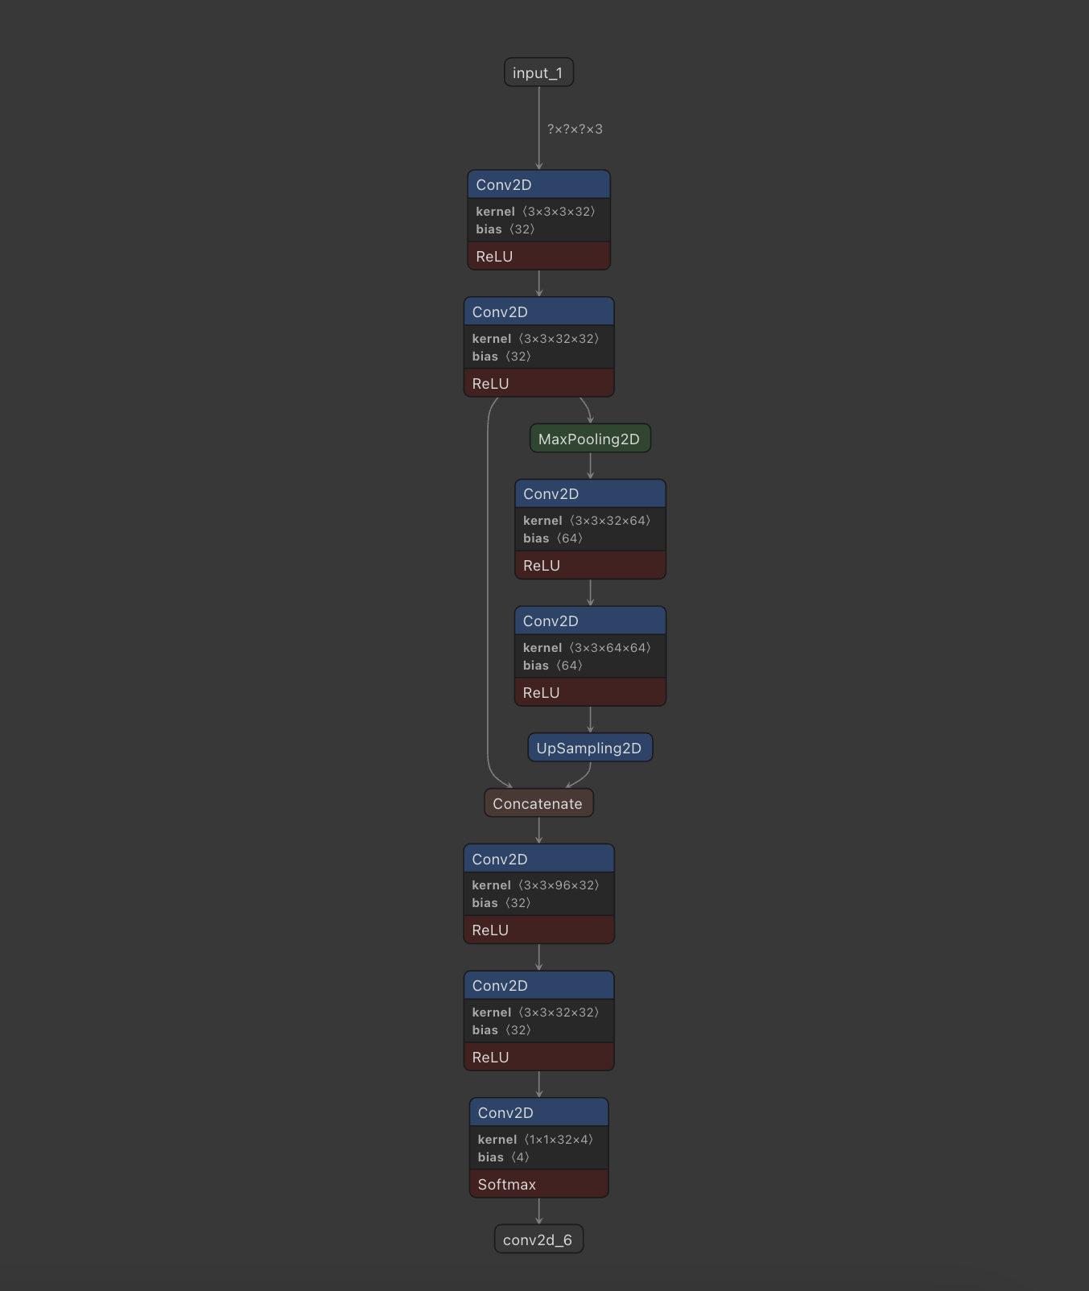
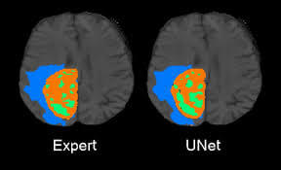
U-Net
UNET is a U-shaped encoder-decoder network architecture, which consists of four encoder blocks and four decoder blocks that are connected via a bridge. The encoder network (contracting path) half the spatial dimensions and double the number of filters (feature channels) at each encoder block.

Slide 8
U- Net Approach
U-Net is a type of convolutional neural network (CNN) that was developed specifically for biomedical image segmentation. It was introduced by Olaf Ronneberger, Philipp Fischer, and Thomas Brox in their paper "U-Net: Convolutional Networks for Biomedical Image Segmentation," which was presented at the International Conference on Medical Image Computing and Computer-Assisted Intervention (MICCAI) in 2015.
The name "U-Net" comes from the U-shaped architecture of the network, which consists of an encoding (down sampling) path and a decoding (up sampling) path, connected by skip connections.
Here's an explanation of the U-Net architecture:
Encoder (Down sampling Path):
The encoder path extracts features from the input image through a series of convolutional layers and max-pooling operations.
At each level of the encoder, the spatial dimensions of the feature maps are reduced by half (via max-pooling), while the number of channels (feature maps) is increased.
Decoder (Up sampling Path):
The decoder path reconstructs the segmentation mask from the encoded feature maps.
At each level of the decoder, the spatial dimensions of the feature maps are increased by a factor of two (via upsampling), and the number of channels is decreased.
The decoder receives input from both the encoder and the previous layer of the decoder through skip connections.
Skip Connections:
Skip connections are used to transfer feature maps from the encoder to the corresponding level in the decoder.
These connections help preserve fine-grained spatial information that is lost during down sampling.
The feature maps from the encoder are concatenated with the feature maps in the decoder to provide additional context.
Output Layer:
The final layer of the U-Net produces a segmentation mask, where each pixel is assigned a label corresponding to a specific class.
The output layer often uses a SoftMax activation function to produce class probabilities for each pixel.
The U-Net architecture has become a popular choice for image segmentation tasks due to its ability to capture both high-level and low-level features, as well as its effectiveness in handling small datasets. Since its introduction, U-Net has been adapted and modified for various applications, including medical image analysis, satellite image segmentation, and autonomous driving.

Slide 9
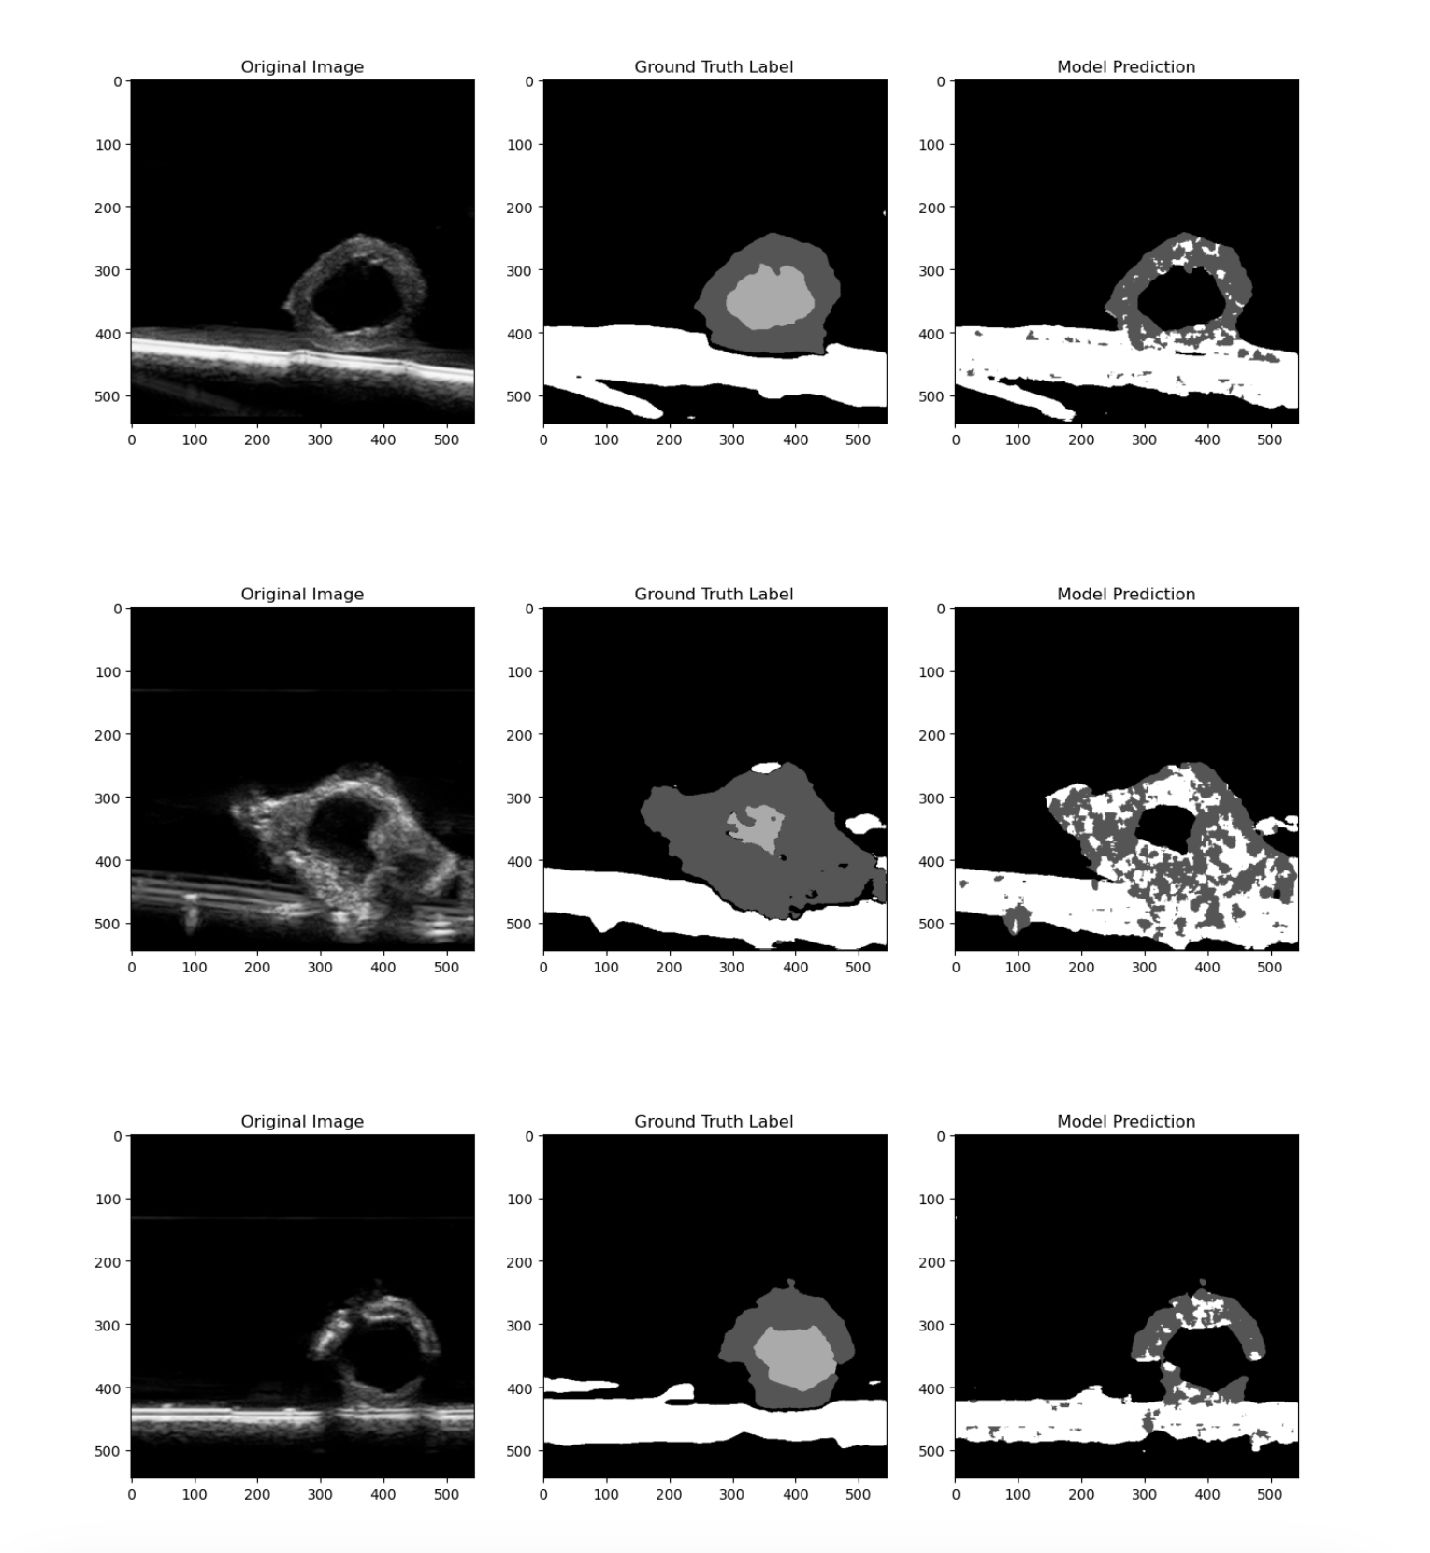
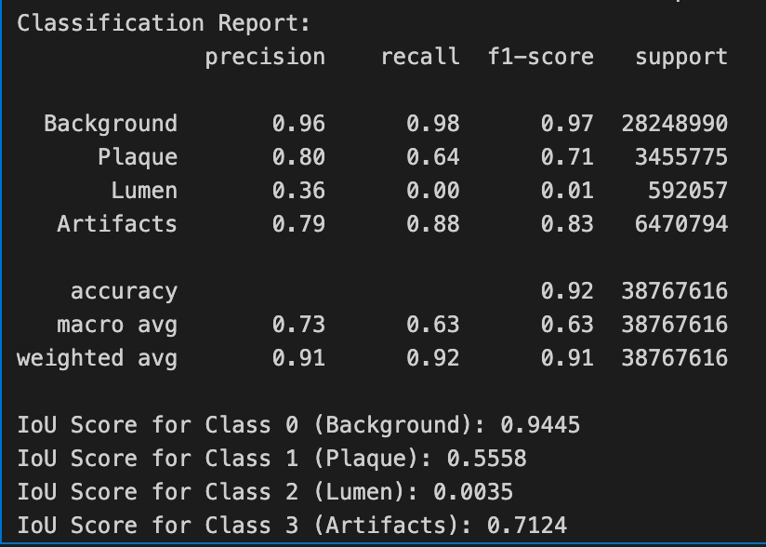
Results

Slide 10
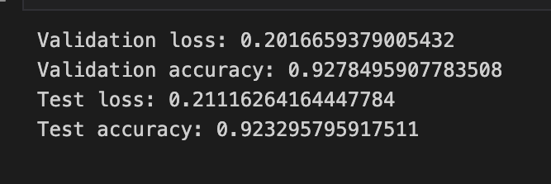
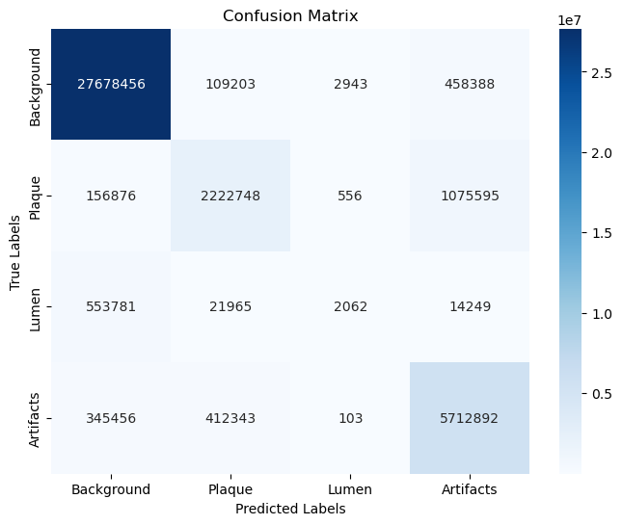
Conclusion and Challenges
"The matrix indicates that the classifier is performing well in predicting Background, Plague and Artifacts classes (high diagonal values), while it has some difficulty in accurately predicting the Lumen classes (low diagonal values and high off-diagonal values). ”
High Complexity- Time Consuming.
Lack of Data – on the Internet
Machine Hinderence

Slide 11
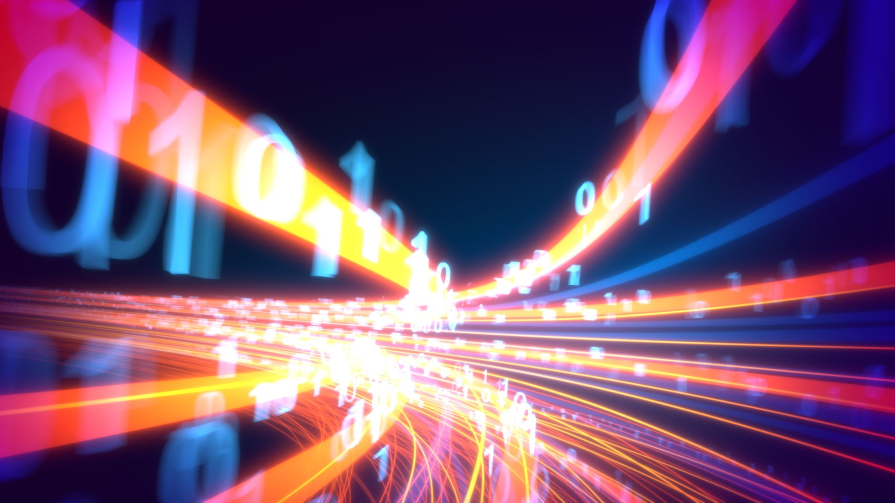
Future Use Demo - By Yash Vats

Slide 12

References
https://rdcu.be/djKW0 "Performance of a Deep Neural Network Algorithm Based on a Small Medical Image Dataset: Incremental Impact of 3D-to-2D Reformation Combined with Novel Data Augmentation, Photometric Conversion, or Transfer Learning"
https://doi.org/10.3390/jpm12030420 "Artificial Intelligence in Cardiovascular Atherosclerosis Imaging"
Datasets:
https://www.kaggle.com/datasets/hey24sheep/mayoclinicdataset
https://www.kaggle.com/datasets/davidpiln/atherosclerosis-segmentation

Slide 13

Thank you
This Photo by Unknown author is licensed under CC BY-NC-ND.

